Slide 1
roomi
Week 7 Progress
Marko Javorac, Jacob Ladan, Denald Demirxhiu
Github: https://github.com/jacobladan/roomi

Slide 2

Scope
UI/Layouts
Schedule
Test Plans
Database
What’s Next

Slide 3

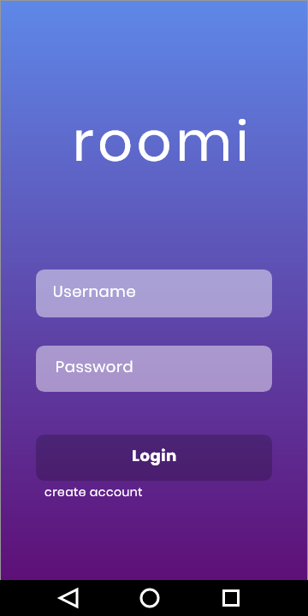
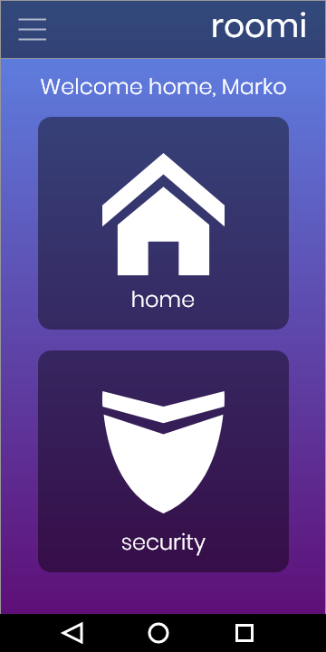
UI - Login

Slide 4
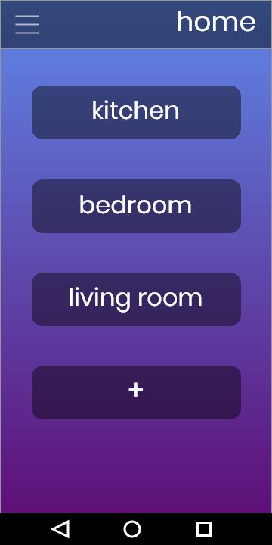
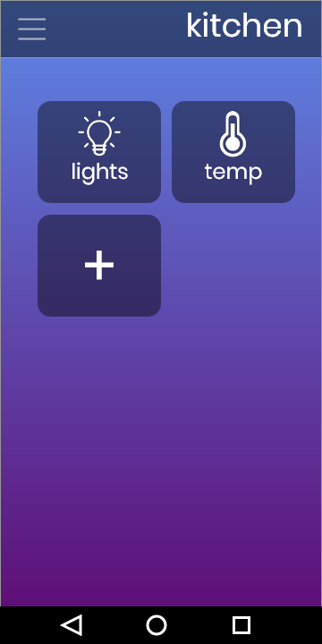
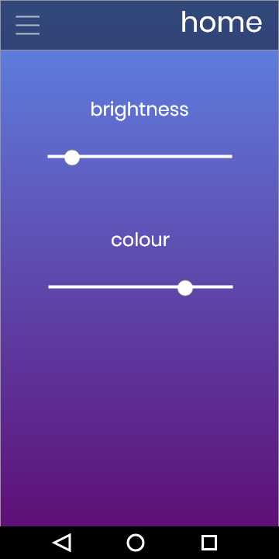
UI - Smart Home Settings

Slide 5
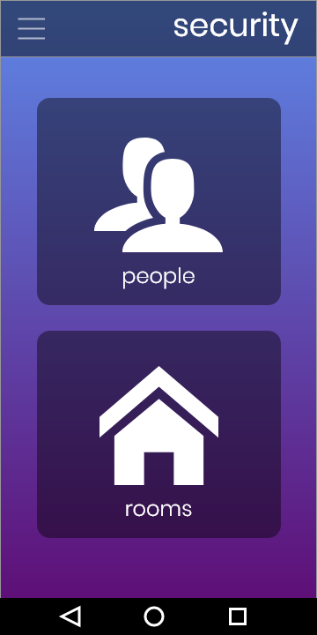
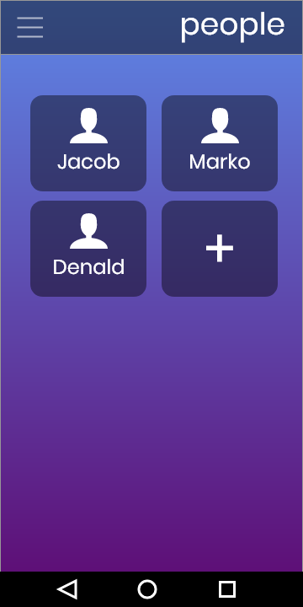
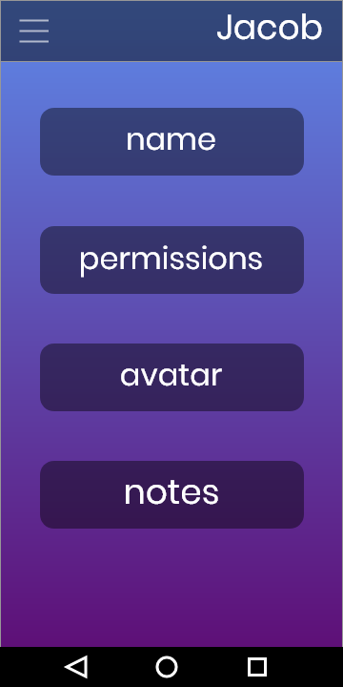
UI - Adjusting Personnel Info

Slide 6
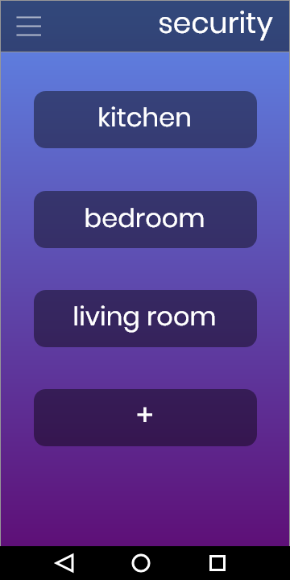
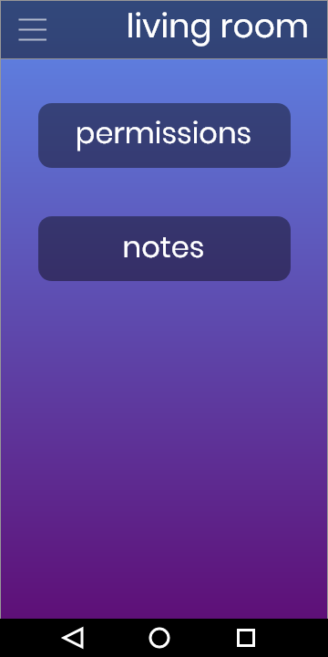
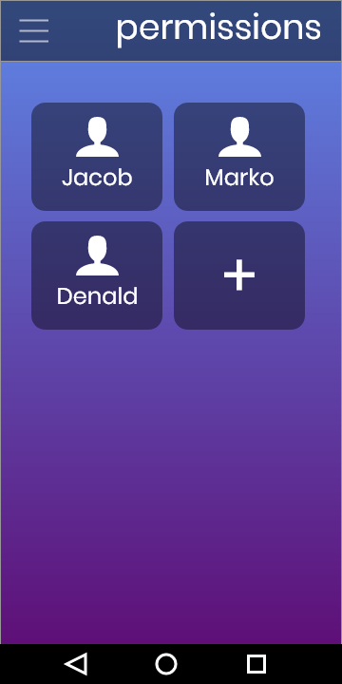
UI - Adjusting Personnel Access Privileges

Slide 7
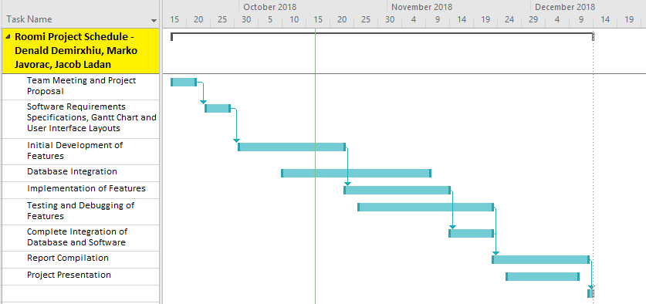
Schedule

Slide 8

Test Plans - General
Application launches
Navigates to Appropriate Pages
Close/Re-open from Memory
Navigation Drawer
Responsive Design
Notes:
TODO - Review and expand test examples

Slide 9
Test Plans - roomi Specific
Client/Server Login Verification
Connection to Database
Add/Remove Rooms and Personnel
Update Room and Personnel Information
Update Permissions and Room Hardware Settings

Slide 10
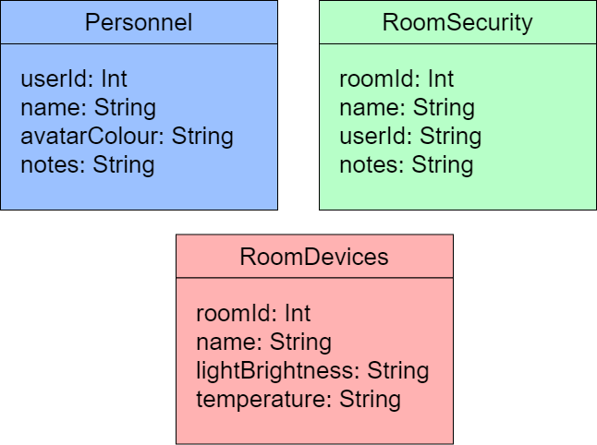
Database Design
No SQL
JSON
Google Firebase

Slide 11

Future Plan
Remaining Layouts
Database
Communication with Database
Testing and Debugging
Final Report
Hardware Integration

Slide 12
Thank You!

